Slide 1
ATTACK-RESISTANT BACKUP AND RECOVERY SYSTEM
1. Naaol Raffisaa CTC-1138-26
  Task: Isolation & Recovery
  Branch: feature/isolation-recovery
2. Abenezer Tekalign CTC-7212-26
  Task: API & Dashboard
  Branch: feature/api-dashboard
3. Eden Mulugeta CTC-4135-26
  Task: Backup & Integrity
  Branch: feature/backup-integrity
✓
4. Befikir Shimelis CTC-674-26
  Task: Wazuh & Detection
  Branch: feature/wazuh-detection
5. Lameik Equar CTC-3115-26
  Task: Event Collection & Risk Engine
  Branch: feature/risk-engine
6. Naboni Abrham CTC-459-26
  Task: Decision Engine
  Branch: feature/decision-engine
Year: 2026
Notes:
Introduce the project: a system that supports security monitoring, backup integrity verification, and data recovery.

Slide 2
CYBERSECURITY • DATA RESILIENCE
ATTACK-RESISTANT BACKUP AND RECOVERY SYSTEM
✓
Project Presentation
Smarter Detection. Safer Backups. Stronger Recovery.
Year: 2026
Notes:
Introduce the project: a system that supports security monitoring, backup integrity verification, and data recovery.

Slide 3
01 • THE PROBLEM
The problem we address
Important digital data can be threatened by ransomware, malware, unauthorized access, and accidental changes.
KEY CHALLENGES
1
2
3
4
Security incidents can damage or modify important files.
Backups may become corrupted or compromised.
Recovery can be difficult without trusted backup copies.
Manual monitoring and recovery can take time.
OUR GOAL Develop a system that supports security monitoring, backup integrity verification, and data recovery.
ATTACK-RESISTANT BACKUP & RECOVERY SYSTEM
02 / 07
Notes:
Explain the threats and the four challenges, then state the goal.

Slide 4
02 • OBJECTIVES & FEATURES
Project objectives and main features
1
Security-Event Handling
2
Risk Assessment
3
Backup Protection
Provides backend functionality for receiving and reviewing security events.
Helps evaluate security events and classify their risk levels.
Supports backup management and integrity verification.
4
Recovery Support
5
Monitoring Dashboard
Provides components for recovering data from trusted backups.
Offers a central interface for viewing system status and security information.
ATTACK-RESISTANT BACKUP & RECOVERY SYSTEM
03 / 07
Notes:
Walk through the five objectives.

Slide 5
03 • ARCHITECTURE
System architecture
MAIN COMPONENTS
React dashboard
Python FastAPI backend
1
2
Wazuh security monitoring integration
Security-event collection and risk assessment
3
4
Backup protection and integrity verification
Backup storage and recovery components
5
6
SYSTEM FLOW
Detection
→
Event Collection
→
Risk Analysis
→
Decision Making
→
Action Execution
→
Recovery & Reporting
The architecture illustrates how the components are designed to work together to support security monitoring, backup protection, and recovery.
ATTACK-RESISTANT BACKUP & RECOVERY SYSTEM
04 / 07
Notes:
List the main components and the end-to-end flow. The next slide shows the full architecture diagram.

Slide 6
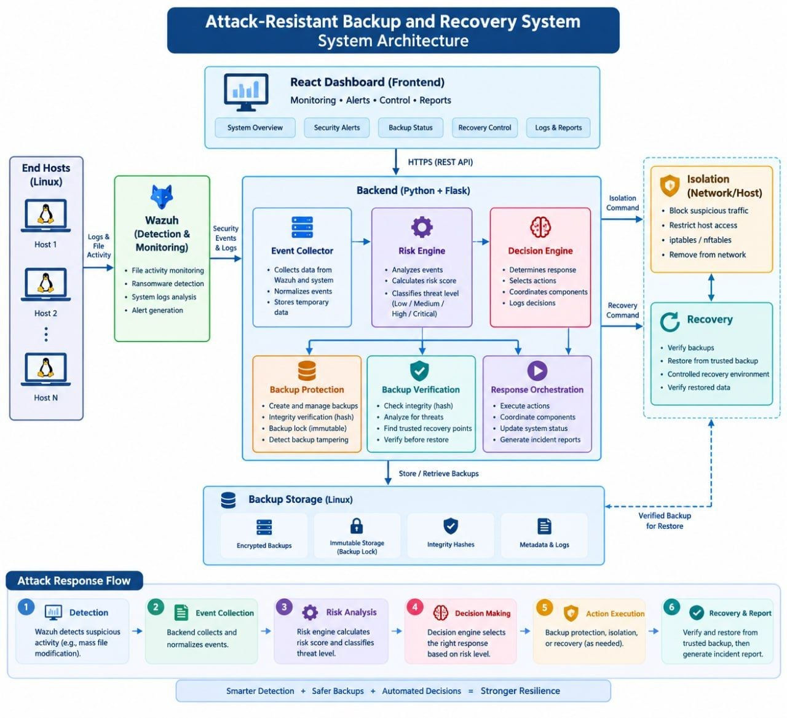
03 • ARCHITECTURE DIAGRAM
05 / 07
Notes:
Full architecture diagram: end hosts feed Wazuh; the backend collects events, scores risk, and decides; backup protection, verification, and orchestration act; isolation and recovery respond; backup storage keeps encrypted, immutable, hashed backups.

Slide 7
04 • HOW IT WORKS
How the system works
1
Step 1: Detection
2
Step 2: Event Collection
3
Step 3: Risk Analysis
A monitoring tool identifies suspicious activity.
The backend receives and processes security-event information.
The risk engine evaluates the event and classifies its severity.
4
Step 4: Decision Making
5
Step 5: Action Execution
6
Step 6: Recovery and Reporting
The decision logic selects an appropriate response.
The system may select a protection, isolation, or recovery action, depending on the implemented workflow.
Backup integrity is checked before restoration, and relevant results can be recorded.
ATTACK-RESISTANT BACKUP & RECOVERY SYSTEM
06 / 07
Notes:
Walk through the six steps from detection to recovery and reporting.

Slide 8
05 • CONCLUSION
Conclusion
The Attack-Resistant Backup and Recovery System aims to improve data protection through security-event handling, risk assessment, backup integrity verification, and recovery support.
KEY BENEFITS
✓
✓
✓
✓
Centralized security information
Improved backup integrity checking
Support for safer data recovery
A foundation for coordinated security response
Thank You!
ATTACK-RESISTANT BACKUP & RECOVERY SYSTEM
07 / 07
Notes:
Summarize the benefits, share the repository link, and thank the audience. Replace the repository placeholder before submitting.

